Slide 1
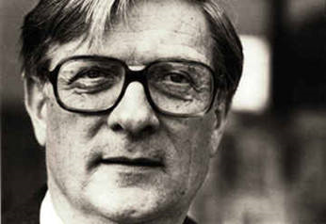
Kenneth Noland
Born 1924, Asheville, North Carolina

Slide 2

Split
1959

Slide 3

Extent
1959

Slide 4
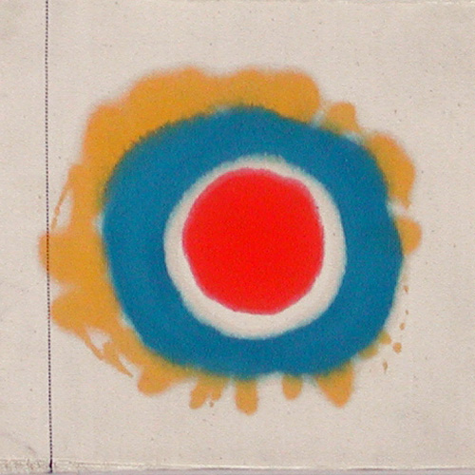
“Untitled”
1959

Slide 5
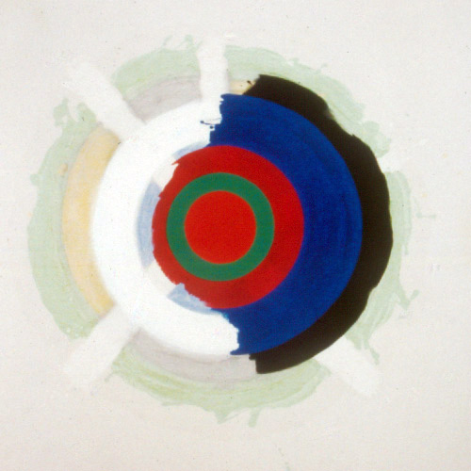
Back and Front
1960

Slide 6
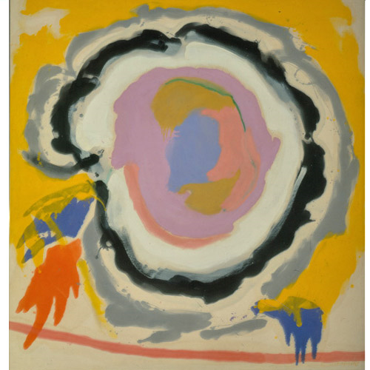
Ex-Nihilio
1958

Slide 7
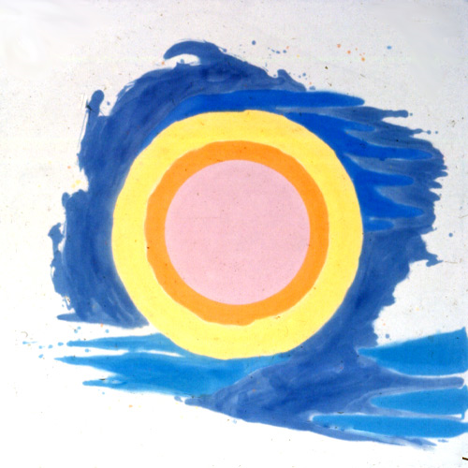
Lunar Episode
1958

Slide 8
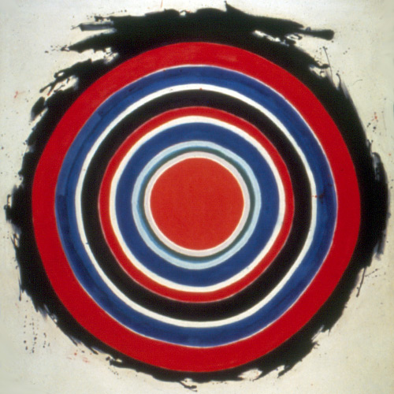
Beginning
1958

Slide 9
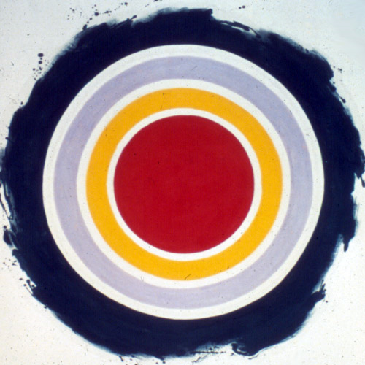
And Half
1959

Slide 10
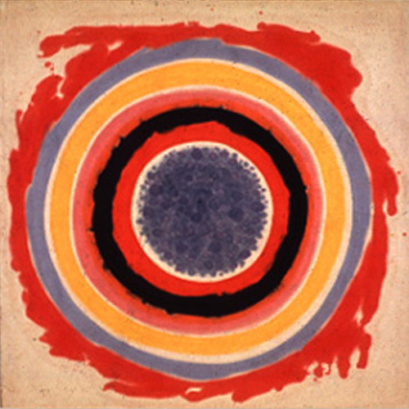
Inside
1958

Slide 11
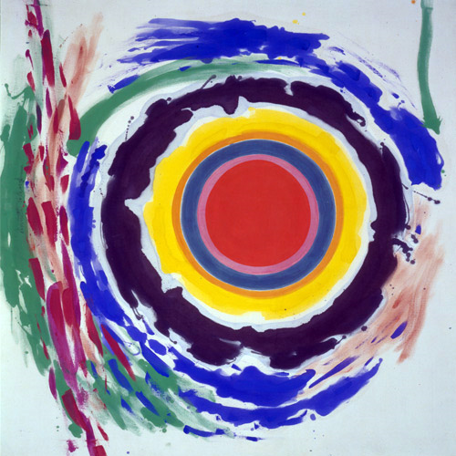
Heat,
1958

Slide 12
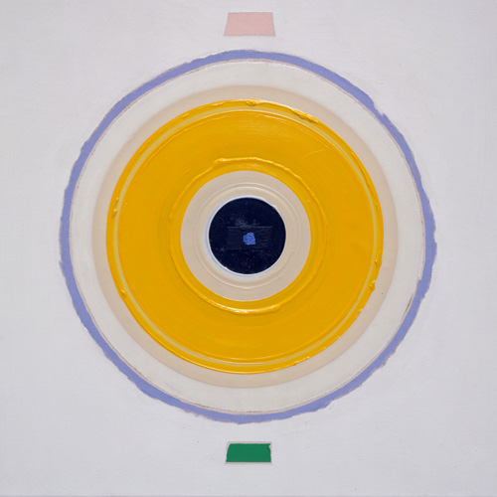
Refresh
1999

Slide 13
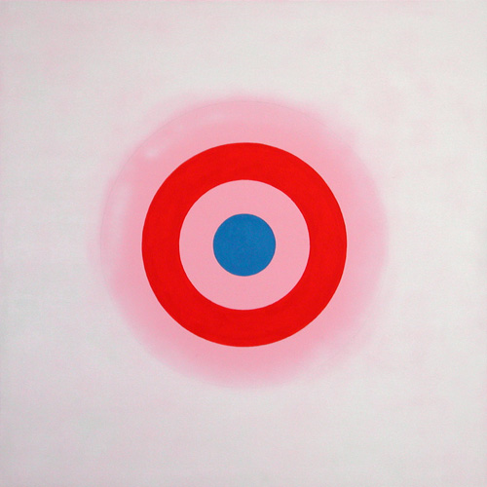
MYSTERIES: INFANTA, 2000

Slide 14
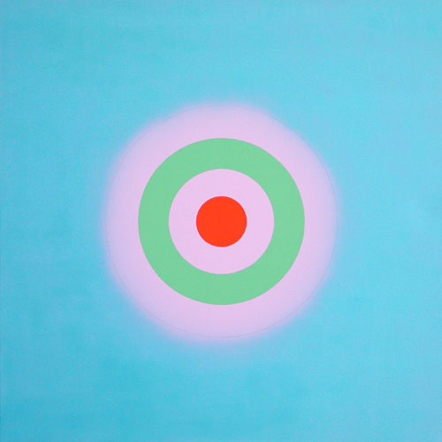
MYSTERIES: AFLOAT, 2000

Slide 15
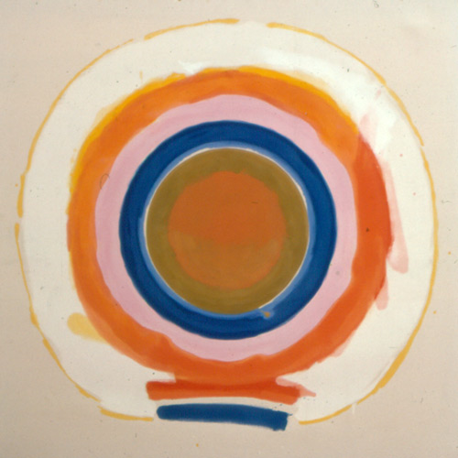
Quid,
1960

